Slide 1


Communication Skills part 1
Week 5: Evaluation element in Gibbs’ model &
Paragraph structure

Slide 2
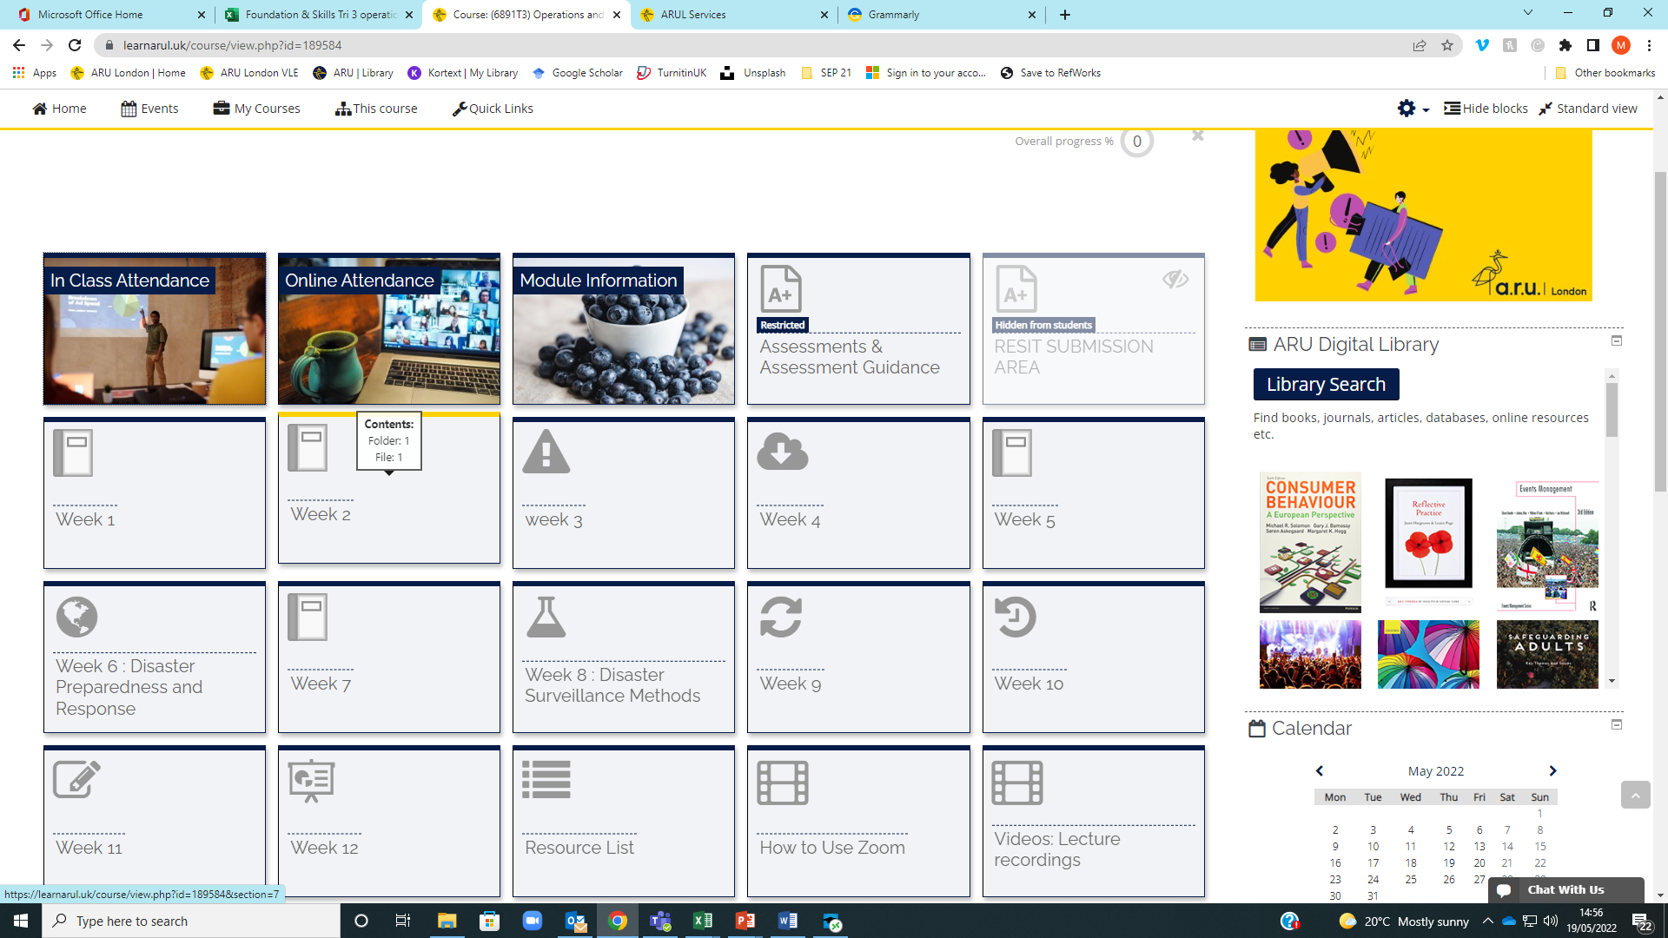

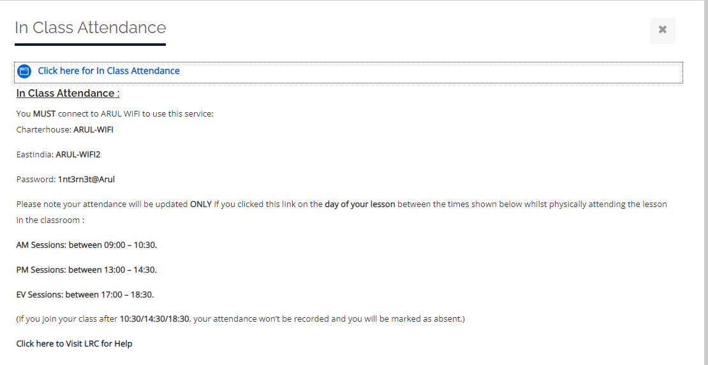

Registering your in Class attendance
Step 1: Ensure you are logged into the ARUL-Wi-Fi.
The password is: 1nt3rn3t@Arul
Step 2: Login to the VLE and go to the module page for your class.
Step 3: Click on In Class attendance
Step 4: Click on the link highlighted in blue. The word submitted will appear on your screen if you have followed the procedure
Step 5: Repeat this process for your PM/AM class
Notes:
Get all students to register their attendance for todays WW session
This is the process they will follow for attending classes next week, but they need to select the module they will be studying
32

Slide 3

Learning outcomes:
By the end of this session, you will have:
Discussed the third element in your reflective writing – Evaluation.
Identified and discussed the structure of a paragraph for reflective writing purposes.
Discussed and practiced constructing topic sentences, supporting details and summary sentences.
Notes:
32

Slide 4
Homework 2 - Reading
Last week, you were asked to read pp. 24-28 (Reflecting on yourself and your experiences). Work in groups of 3 or 4, and discuss the following:
How did the Product Design students’ opinions / thoughts change from when they met the first time to after the completion of the project?
Look at the journal entries on page 27. How different or similar are the entries in your reflective journal?
What verb forms can you use to talk about things from the past, in the present and to the future times? Can you think of examples?
Write wrote writing
Drive drove driving
Eat eate eating
Notes:
32

Slide 5

Evaluation

Slide 6
Evaluation in Gibbs’ model
We have seen the first two elements in Gibbs’ reflective cycle – Description and Feelings/thoughts. This week, we are discussing the 3rd element – Evaluation.
You have read parts of your coursebook and watched various videos on reflective practice.
Work with a person next to you and discuss:
1. What does ‘evaluate’ mean?
Weighs the evidence, good or bad, Before conclusion, judgement,
2. What do you know about the Evaluation element in Gibbs’ model?
3. What questions can help you evaluate your experience?
4. Any other information relating to evaluating your topic / event / situation?
Notes:
Source: Williams, Woolliams & Spiro (2020) Reflective writing. Bloomsbury: London
32

Slide 7
How to evaluate your experience?
Evaluation is asking yourself – what was good and bad about the experience? This section should provide a balanced appraisal of the situation.
Here you have a chance to evaluate what worked and what didn’t work in the situation. Try to be as objective and honest as possible.
To get the most out of your reflection, focus on both the positive and the negative aspects of the situation, even if it was primarily one or the other.
University of Edinburgh, 2021
Notes:
Source: https://www.ed.ac.uk/reflection/reflectors-toolkit/reflecting-on-experience/gibbs-reflective-cycle
Source info:
https://libguides.hull.ac.uk/writing/voice
32

Slide 8
Helpful questions to evaluate
What was good and bad about the experience?
What went well?
What didn’t go so well?
What did you and other people contribute to the situation (positively or negatively)?
How was the overall outcome? Good or bad?
Edinburgh University, 2022
Notes:
https://www.ed.ac.uk/reflection/reflectors-toolkit/reflecting-on-experience/gibbs-reflective-cycle
Source info:
https://owl.purdue.edu/owl/general_writing/academic_writing/active_and_passive_voice/active_versus_passive_voice.html
32

Slide 9
Week 5 – Activity 1
Take Activity 1 in Week 5 worksheet.
Look at the example Evaluation paragraph. It is based on a groupwork assignment. Work in pairs and discuss the following:
1. Is the paragraph a good Evaluation of the experience? Why(not)?
2. How many aspects worked well and how many did not, according to the writer?
3. Is the paragraph coherent enough? What makes it coherent?
4. Underline all cohesive devices that you can identify within the text (we discussed cohesive devices last week).
5. If you could, how would you write this paragraph better?
University of Edinburgh, 2021
Notes:
Source info:
https://libguides.hull.ac.uk/writing/voice
32

Slide 10
Evaluation in action
Look again at the aspect you have chosen for your assignment. Here they are again (if you don’t remember):
Materials and activities used in your lessons/lectures
ARUL campus facilities and amenities
Involvement and participation in your lessons/lectures
Work in groups of 3 or 4. Speak to your group evaluating your experience (so far) in relation to your chosen topic. Others may ask you questions that can help you think more deeply and evaluate the experience further. Look at the questions on slide 9 if necessary.
Be careful not to go off the topic or task!
Notes:
32

Slide 11
Independent study - Writing week 5
Last week, you wrote the Feelings/Thoughts element of your reflective writing.
This week, write the Evaluation element on the aspect you have chosen for your assignment. The word count for this is 225.
Bring your work to the next session so we can look at it and give you some feedback.
Notes:
32

Slide 12

Paragraph structure
Notes:
32

Slide 13
Discuss in small groups - paragraphs
What is (are) the function(s) of a paragraph?
2. What do you think should go in a paragraph?
3. What issues have you faced (or could you face) while constructing a paragraph?
4. Do you know any standard guidance / procedures / formats for structuring paragraphs, like the PEEL structure?
(Possible answers may be provided by your lecturer).
Notes:
32

Slide 14
For CS1 module:
The assignment for Communication Skills Part 1 is reflective writing. For reflective writing purposes, we will adapt the different paragraph structure models into a simple structure:
Topic sentence
Supporting details
Summary/concluding sentence
(Oshima & Hogue, 2007; Bailey, 2011)
Please remember that Introduction and Conclusion paragraphs may follow a different structure from the above depending on the discipline / subject.
Let us look at the above three elements one by one.
Notes:
32

Slide 15

Topic sentences
Notes:
32

Slide 16
Topic sentence
Topic sentence is a sentence that informs the readers what overall point the paragraph is making.
A topic sentence should appear early in the paragraph and is often, but not always, the first sentence.
A topic sentence not only names the topic of the paragraph, but it also limits the topic to one specific area (called controlling idea) that can be discussed completely in the space of a single paragraph.
Thus, a topic sentence has two components – a topic and a controlling idea. Look at the coloured parts of text in the following examples.
E.g., Gold, a precious metal, is prized for two important characteristics.
The rate of home ownership around the world varies for different reasons.
Notes:
Source: Oshima & Hogue (2007).
32

Slide 17

Activity 2: topic sentences
Go to Activity 2 in Week 5 worksheet.
Work in pairs or groups and complete the activity as instructed.
Then check your answers with the lecturer.

Slide 18

Writing topic sentences
Go to Activity 3 in Week 5 worksheet.
Read the paragraphs one by one and write a topic sentence for each in the space provided.
Then compare your answers in pairs/groups.
For possible answers, please ask your lecturer.
Notes:
32

Slide 19

Break: max. 15 mins
Notes:
32

Slide 20
Supporting details
Notes:
32

Slide 21
Supporting sentences
Go to Activity 4 in the worksheet. Look at the two texts and discuss the following in groups of 3 or 4.
1. How are the texts A and B different from each other?
2. Which paragraph is better in terms of contents, style and structure?
3. What additional details are there in one of them that are not in the other?
Your lecturer may have sample answers.
Notes:
32

Slide 22
Supporting details
Supporting sentences explain or prove the topic sentence.
One of the biggest problems in student writing is that student writers often fail to support their ideas adequately; they need to use specific details to be thorough and convincing. It is also important to focus on ONE idea in a paragraph; this controlling idea should be clearly stated in the topic sentence.
You could use different kinds of supporting details: examples, statistics, quotes, explanation, interpretation etc.
What kind of supporting details can you give in your reflective writing?
Notes:
32

Slide 23
Activity 5
Work in pairs. Go to activity 5 in the worksheet. Look at the paragraph and discuss the following:
Identify and underline the topic sentence.
What is the topic being discussed in the paragraph?
Are there sufficient supporting details in the text to prove the topic? Highlight them.
Are these supporting details examples, data, statistics, explanation, quote or interpretation?
Cross out the sentences that should not be in this paragraph? How do these ‘unrelated sentences’ affect the paragraph?
Notes:
32

Slide 24

Summary sentence or concluding sentence
Notes:
32

Slide 25
Concluding sentence
A concluding sentence serves two purposes:
It signals the end of the paragraph.
It leaves the reader with the most important ideas to remember. It can do this in two ways:
- by summarising the main points of the paragraph
- by repeating the topic sentence in different words (which is called paraphrasing; we will discuss this later on the course)

Slide 26
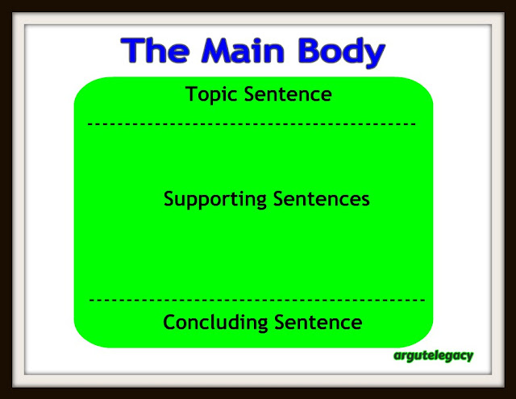
Concluding sentence - example
Look again at the concluding sentence in the paragraph on colours in Activity 5. Is it a summary of the main ideas discussed in the paragraph or a paraphrase of the topic sentence?
Which one would you choose to write a concluding sentence – summarizing or paraphrasing? Why?
This Photo by Unknown Author is licensed under CC BY-SA-NC

Slide 27
Activity 6 – Concluding sentences
Go to activity 6 in the worksheet.
The two paragraphs do not have concluding sentences. Read the paragraphs and write a concluding sentence for each.
Then show them to your partner and seek their opinions/thoughts on them.
If you would like to have sample answers, ask your lecturer.
Notes:
32

Slide 28
In-class writing practice
Notes:
32

Slide 29
Homework 1 - Writing
Last week, you were asked to write the Feelings/Thoughts element on the topic you have chosen for your reflective writing.
Work in pairs, show your example paragraph to your partner and give some feedback on their work. Have they addressed the following?
What were they feeling before, during and after the situation?
What do they think other people were feeling about the situation?
What do they think other people feel about the situation now?
What were they thinking before and during the situation?
What do they think about the situation now?
Notes:
<number>

Slide 30

Notes:
<number>

Slide 31
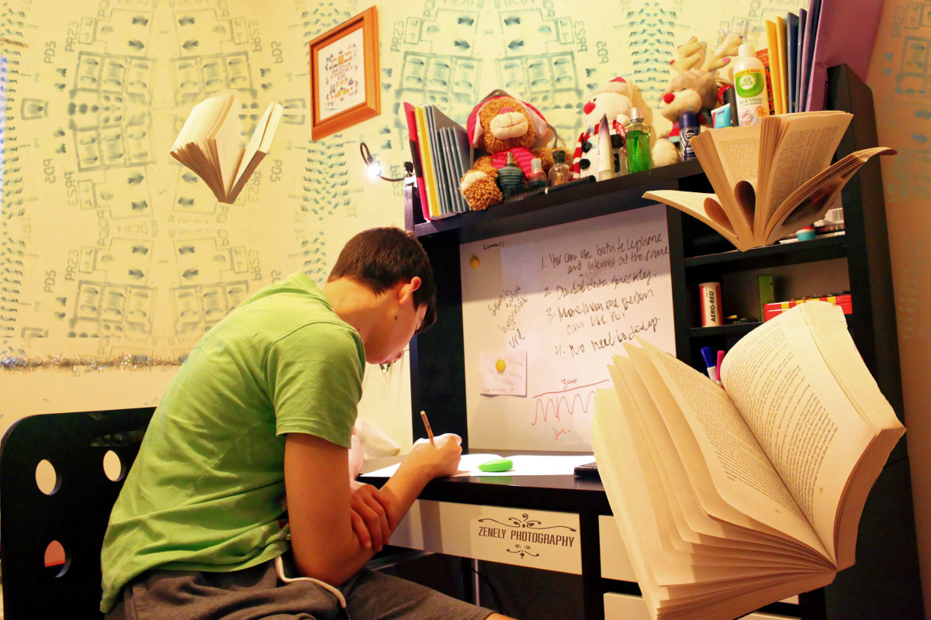
Independent study – Week 5
Go to the ‘Independent study’ section under the Week 4 tile
READ: pp. 110-121 (Gibbs’ Reflective Cycle). Click on the link on VLE or open the PDF on VLE.
ANSWER: Homework Quiz 5 on VLE (To be completed after reading pp. 110-121)
WRITE: Week 5 Independent Study Writing Activity (Check Week 5 on VLE).
Preparation videos for Week 6.
Notes:
<number>

Slide 32
References
Williams, Woolliams & Spiro (2020) Reflective writing. Bloomsbury: London.
Bailey, S. (2011). Academic writing: a handbook for international students (3rd ed.). Routledge: London.
Oshima and Hogue (2007). Writing Academic English. Pearson Longman: NY.
https://canvas.hull.ac.uk/courses/778/pages/paragraph-structure
Williams, Woolliams & Spiro (2020) Reflective writing. Bloomsbury: London.
https://www.ed.ac.uk/reflection/reflectors-toolkit/reflecting-on-experience/gibbs-reflective-cycle

